Slide 1
FUELWATCH WA
Historic Fuel Price
Analysis & Prediction
Member name:
1. Name Anasua Mazumder
ID: S390170
2. Neetu
ID:s392716
3. Nishu Rani
ID: s392936
Assessment 2 — Group Project Presentation
Dataset: FuelWatch WA Historic Prices | Period: 2023–2026 | Records: 3,314,312
PRT564 Data Analytics & Visualisation | CDU

Slide 2
Dataset Overview
3.3M
40
7
10
Total Records
Files Merged
Fuel Types
WA Regions
Key Dataset Columns
PUBLISH_DATE
Date of price publication
PRODUCT_PRICE
Fuel price in cents/litre ← Target Variable
PRODUCT_DESCRIPTION
Fuel type (ULP, Diesel, 98 RON, etc.)
REGION_DESCRIPTION
WA region (Metro, Kimberley, etc.)
BRAND_DESCRIPTION
Fuel brand (7-Eleven, BP, Caltex, etc.)
LOCATION / POSTCODE
Station location details
PRT564 Data Analytics & Visualisation

Slide 3
Data Analysis Pipeline
1
2
3
4
5
6
Data Collection
Preprocessing
Feature Eng.
EDA
Modelling
Evaluation
40 CSV files
2023–2026
FuelWatch WA
Remove nulls
Drop unnamed cols
Filter outliers
Extract: Year
Month, Day
DayOfWeek, Quarter
7 visualisations
Patterns & trends
Correlations
Linear Regression
Ridge Regression
Random Forest
RMSE, MAE, R²
t-test comparison
Feature importance
PRT564 Data Analytics & Visualisation

Slide 4
Exploratory Data Analysis — Key Findings
Price Distribution
Price Over Time
Most prices cluster at 160–210 cents/litre. Right-skewed distribution with multiple peaks reflecting different fuel types. Peak at 180–190c.
Stable ~190c Jan–Aug 2023. Spike to 215c in Sep 2023. Lowest at 183c in Sep 2024. Dramatic jump to 263c in early 2026.
Fuel Type Impact
Regional Variation
E85: 271.8c (0.5% share)
98 RON: 205.4c (22.7%)
ULP: 184.1c (25.9% — most common)
LPG: 139.0c (cheapest, 2.4%)
Kimberley most expensive ~228c. Gascoyne ~211c. Metro cheapest ~194c. Remote areas pay 34c/L more due to transport costs.
Weekly Price Cycle
Correlation Analysis
Confirmed Australian fuel cycle: Tuesday cheapest (~188c), Wednesday most expensive (~202c). 14c difference across the week.
Date features alone show weak correlation with price (–0.06 to 0.02). Confirms need for categorical features (fuel type, region, brand).
PRT564 Data Analytics & Visualisation

Slide 5
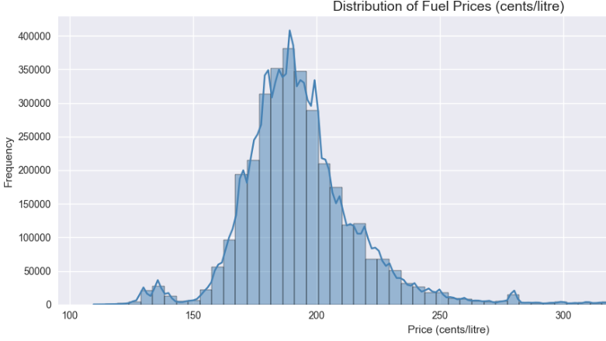
Price Distribution

Slide 6
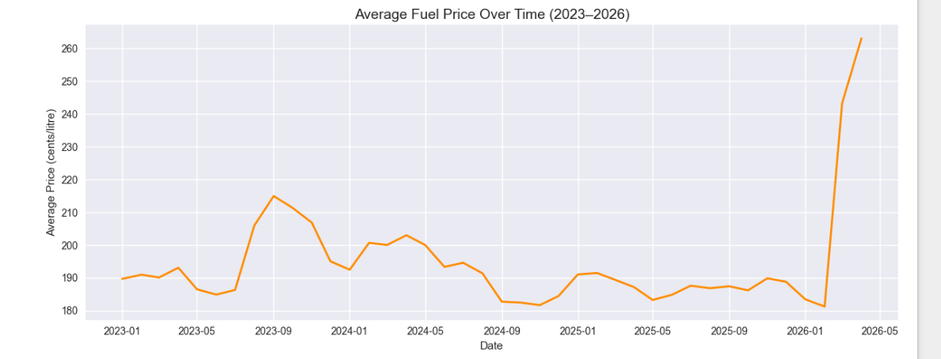
Price over Time

Slide 7
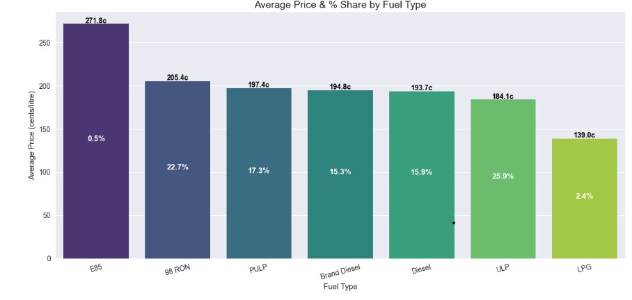
Fuel type impact

Slide 8
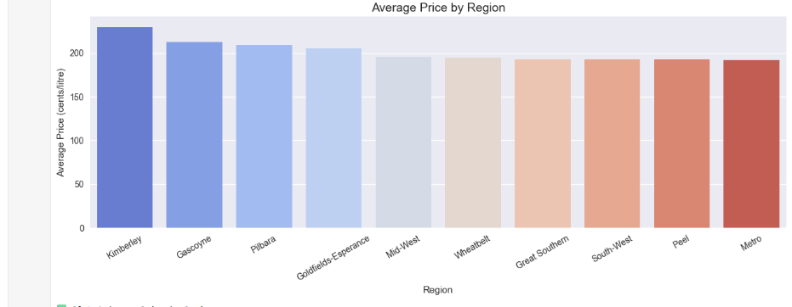
Regional Variation

Slide 9
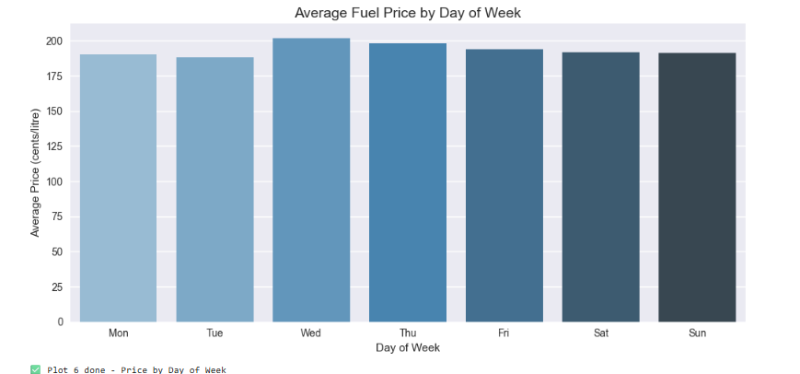
Weekly price Cycle

Slide 10
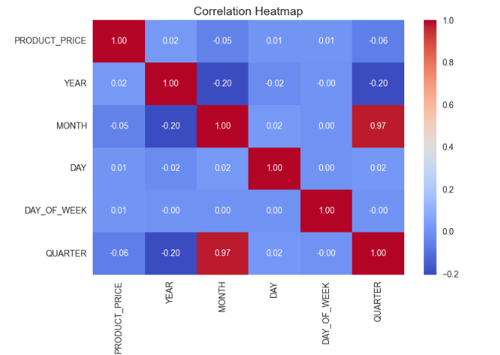
Correlation Analysis

Slide 11
Regression Models — Justification
Linear Regression
01
✔ Why chosen: Baseline model to establish minimum performance benchmark. Simple, interpretable, and fast to train on 3.3M records.
⚠ Limitation: Assumes linear relationships — cannot capture fuel price cycles or sudden spikes.
Ridge Regression
02
✔ Why chosen: Extends linear regression with L2 regularisation. Reduces overfitting and handles multicollinearity between Month/Quarter features.
⚠ Limitation: Still assumes linearity — regularisation alone cannot model non-linear price behaviour.
Random Forest
03
✔ Why chosen: Ensemble of 100 decision trees. Captures non-linear price patterns, fuel cycles, and sudden spikes (like the 2026 surge).
⚠ Limitation: Less interpretable than linear models. Longer training time on large datasets.
PRT564 Data Analytics & Visualisation

Slide 12
Model Evaluation Results
Model
RMSE
MAE
R² Score
Verdict
Linear Regression
23.437
16.512
0.0806 (8%)
❌ Poor
Ridge Regression
23.437
16.512
0.0806 (8%)
❌ Poor
Random Forest
6.901
4.342
0.9203 (92%)
✅ Excellent
Statistical Test: Independent t-test (Linear vs Random Forest)
t-statistic = 0.6629 | p-value = 0.507 | Result: p > 0.05 → No significant difference between Linear & Ridge → Both perform equally poorly
Feature Importance (Random Forest)
FUEL TYPE
30.2%
MONTH
27.1%
YEAR
11.6%
REGION
10.9%
BRAND
6.7%
DAY OF WEEK
6.1%
DAY
5.5%
QUARTER
1.9%
PRT564 Data Analytics & Visualisation

Slide 13
Limitations & Conclusion
⚠ Limitations
✅ Conclusion
Dataset limited to Western Australia only — may not generalise nationally
Random Forest achieved 92% accuracy — best model for fuel price prediction
No external features used (crude oil prices, AUD exchange rate, inflation)
Fuel type & month are the strongest price predictors (57% combined importance)
2026 price spike may represent data anomaly affecting model training
EDA confirmed the well-known Australian weekly fuel price cycle
Random Forest is less interpretable than linear models
Regional pricing inequity identified: remote communities pay 34c/L more
Real-time prediction would require live data pipeline integration
Future work: integrate global oil prices and real-time prediction pipeline
Thank You | Questions Welcome | PRT564 Assessment 2 — CDU

Slide 14
Team Contributions
Anasua
Neetu
Nishu
Data Preprocessing,
Feature Engineering & EDA
Regression Modelling
Model Evaluation
& Conclusion
Merged 40 CSV files into one dataset
Cleaned data — removed nulls & outliers
Extracted 5 features from PUBLISH_DATE
Encoded categorical columns (Fuel, Region, Brand)
Created all 7 EDA visualizations
Identified Australian fuel price cycle
Implemented Linear Regression model
Implemented Ridge Regression model
Implemented Random Forest (100 trees)
Performed 80/20 train-test split
Justified model selection decisions
Documented Python code with comments
Calculated RMSE, MAE and R² for all models
Conducted independent t-test comparison
Analysed feature importance scores
Created Actual vs Predicted plots
Interpreted findings for non-technical audience
Prepared limitations and future recommendations

